Slide 1
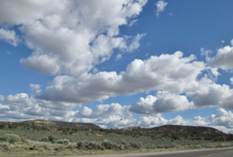
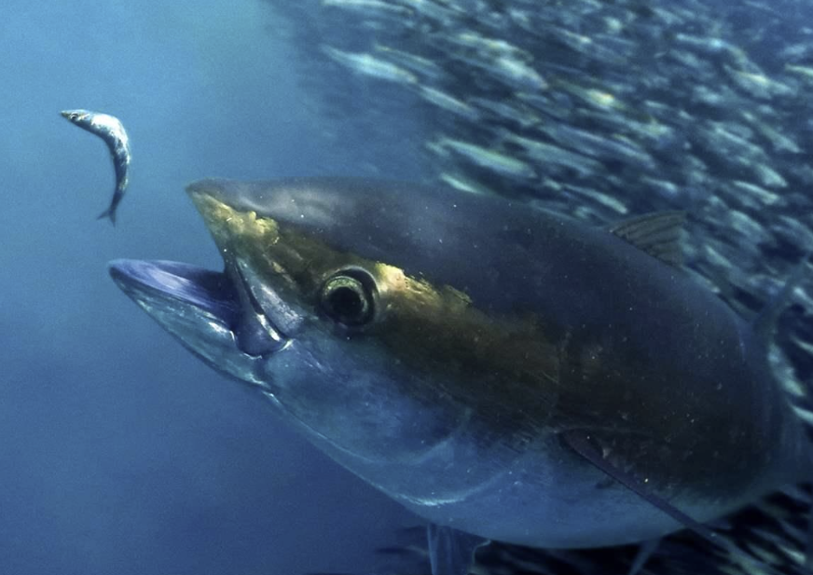
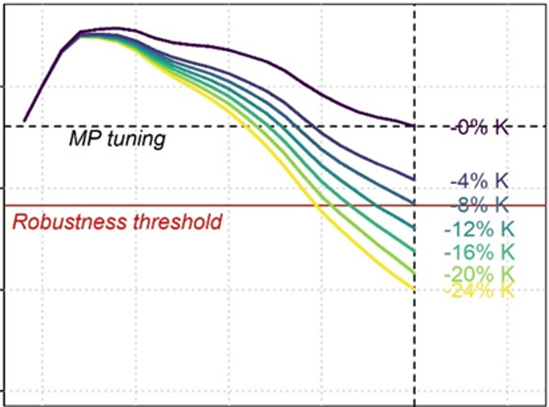
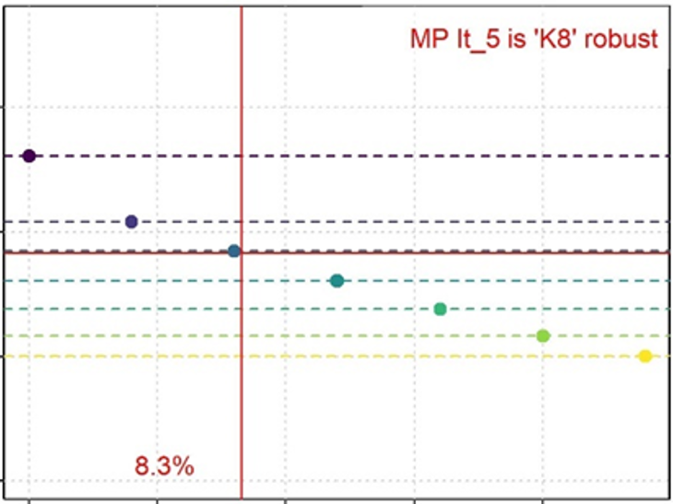


Developing the Climate Test: Performance Metrics of Climate Robustness
ICCAT SCRS/2024/148
Tom Carruthers
25th October 2024, IOTC Methods

Slide 2
Contents
The Problem
Simplification
A solution: metrics not operating models
Methods
Results
Discussion & Conclusions

Slide 3
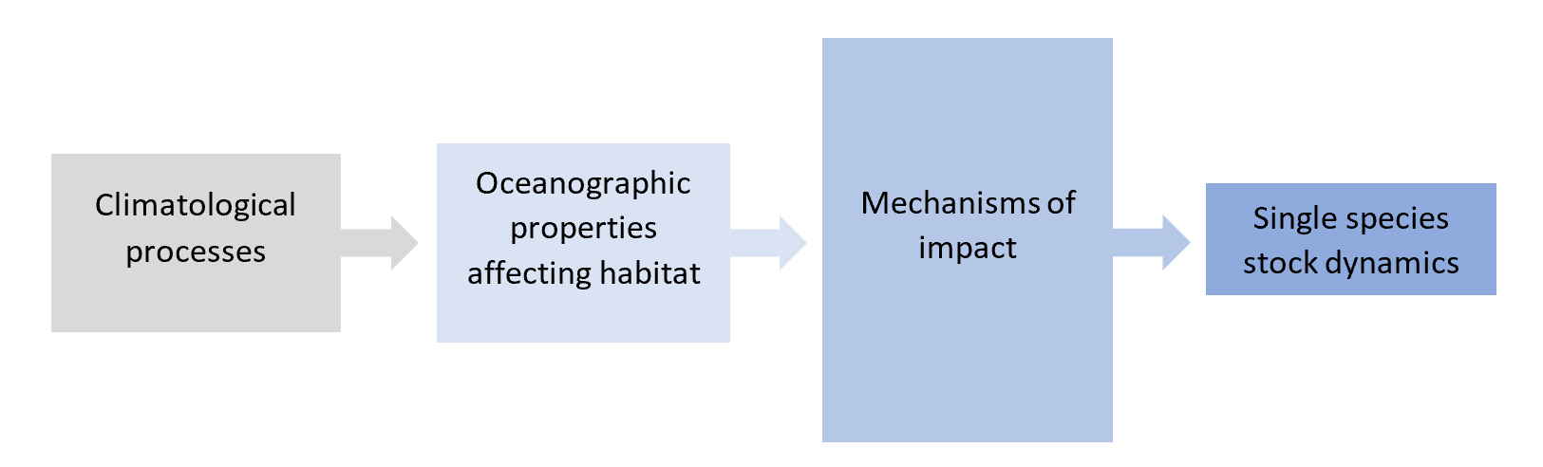
1. The Problem
Marine communities are expected to experience increased impacts from factors relating to climate change.
There is a need for fishery management practices that are robust to changing environmental conditions, population and fishery dynamics.
Forecasting of quantitative impacts is highly uncertain and the relative credibility of scenarios is unknown. Forecasts are the product of various theoretical models, for which empirical support varies:
If scientific uncertainty over climate impacts on fish populations is inevitably very high, should this necessarily obstruct progress in establishing robust fishery management practices?

Slide 4
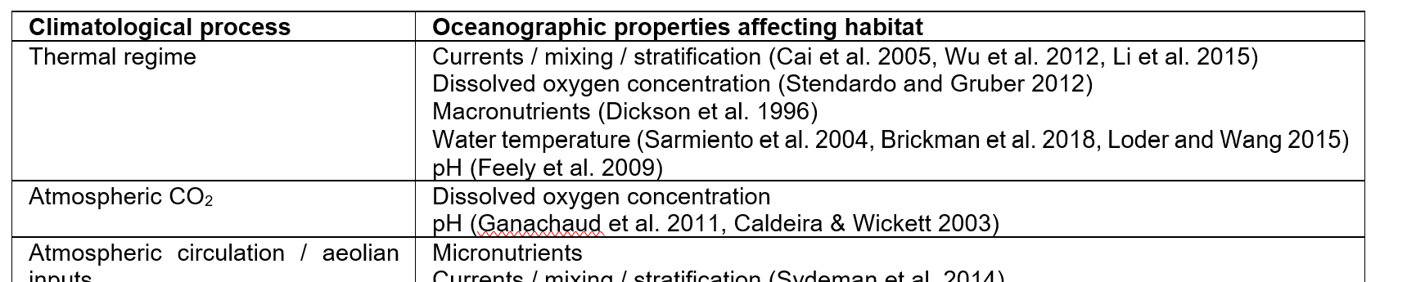
2. Simplification
A previous paper (SCRS/2024/104) reviewed the climate – ocean science / fisheries literature and summarized the pathways to impacts on individual stocks starting with climatological processes.

Slide 5
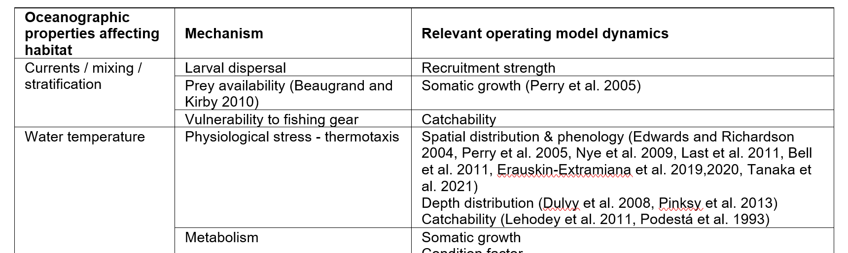
2. Simplification
A previous paper (SCRS/2024/104) reviewed the climate – ocean science / fisheries literature and summarized the pathways to impacts on individual stocks starting with climatological processes.

Slide 6
3. Simplification
A previous paper (SCRS/2024/104) reviewed the climate – ocean science / fisheries literature and summarized the pathways to impacts on individual stocks starting with climatological processes.
Only really 6 types of impact on a stock:
Survival (natural mortality, M)
Somatic growth
Condition factor
Recruitment strength (larval M)
Spatial distribution
Carrying capacity (unfished pop size)
1000s of papers
few quantitative forecasts
more than 35 mechanism – stock dynamics linkages

Slide 7
2. Simplification
‘Problematic’ direction is also known:
Survival (natural mortality, M) Decreasing (increasing M)
Somatic growth Decreasing (e.g., declines in K and Linf)
Condition factor Decreasing (declines in weight at age)
Recruitment strength (larval M) Decreasing
Spatial distribution Range contraction, towards fishing
Carrying capacity (unfished pop size) Decreasing

Slide 8
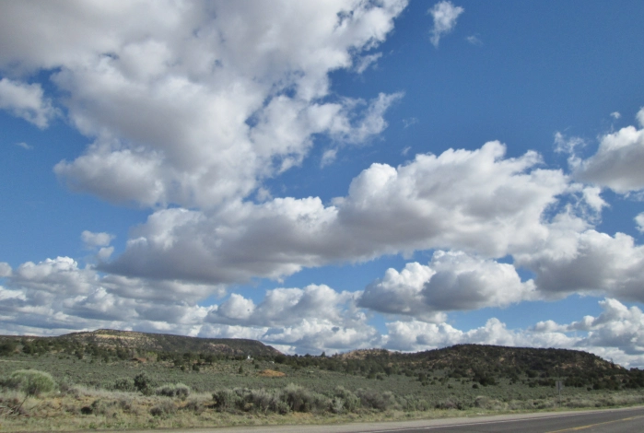






We can’t forecast with certainty
3. A solution: Metrics not Operating Models
Performance rating
 | Cloud: 8 | Dusk: 7 | Storm: 7
 | Cloud: 9 | Dusk: 8 | Storm: 8
 | Cloud: 7 | Dusk: 8 | Storm: 4
But we can test performance

Slide 9
3. A solution: Metrics not Operating Models
Climate Test: | ‘M’ Increasing natural mortality rate | ‘R’ Decreasing recruitment strength | ‘K’ Decreasing somatic growth | ‘C’ Decreasing condition factor | ‘Q’ Range contraction – increasing catchability | ‘S’ Decreasing carrying capacity
Management Procedure 1
Management Procedure 2
Management Procedure 3

Slide 10
4. Methods
Converted the Base 2022 SS3 stock assessment for bigeye tuna into an OpenMSE operating model.
Created three archetypes of management procedure (following the types adopted / tested for bluefin and swordfish and MSEs elsewhere)
(It) Index target (more TAC if index above target level, less TAC if index below target level)
(Ir) Index ratio (TAC = θ x index)
(Is) Index slope (more TAC if index is increasing, less TAC if index is decreasing)
Created two derivatives of each MP archetype:
(_5) Maximum of 5% changes in TAC among years (It_5, Ir_5, Is_5)
(_10) Maximum of 10% changes in TAC among years (It_10, Ir_10, Is_10)
Tested these 6 MPs for future scenarios for increasing natural mortality rate (M), decreasing recruitment strength (R), decreasing somatic growth (K) and decreasing condition factor (C)

Slide 11
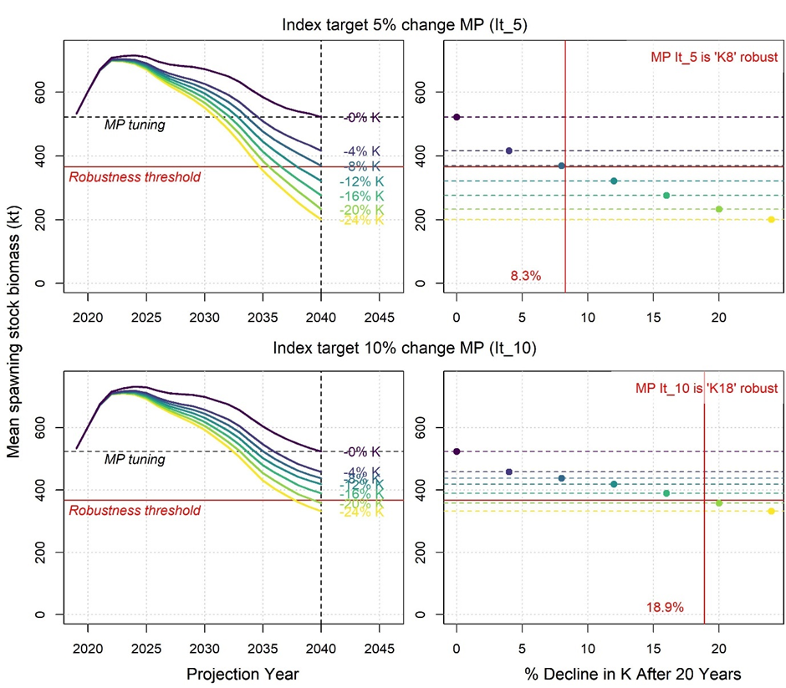
4. Methods
Defined a threshold for ‘robust’ as a decline in biomass of more than 30% after 20 projected years
Tuned a range of empirical MPs to zero trend (flat) over 30 projected years
Imposed increasing levels of each climate test and recorded the level where the MP passed the threshold:
Spawning Biomass (kt)
Projection Year
Value of somatic growth parameter K

Slide 12
The Index target MP is substantially more robust to climate scenarios when it allows for TAC changes of 10%

Slide 13
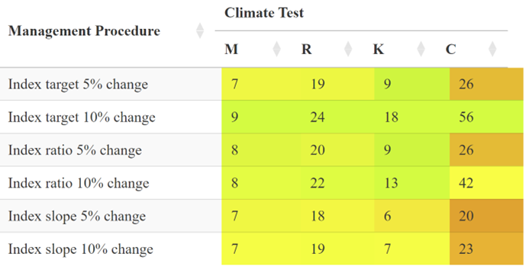
5. Results
Tabulated numbers are the percentage change in each impact before the robustness threshold is reached. Higher percentages that are shaded green represent higher robustness. Shading is scaled per climate test (by column) according to the maximum robustness (highest %)
M = increasing natural mortality rate
R = decreasing recruitment strength
K = decreasing somatic growth
C = decreasing condition factor (weight at age)
Index target MP allowing up to a 10% TAC change was consistently more ‘climate robust’ than the other MPs
Smaller % changes in M were required to breach the threshold (MPs were most sensitivity to M, then K, then recruitment, then condition factor)
The highest variability in climate resilience occurred with respect to condition factor

Slide 14
5. Discussion and Conclusions
Should we wait for scientifically defensible forecasts for individual taxon and location before developing climate-robust management advice?
There are relatively few types of single-species impacts arising from 1000’s of papers on possible pathways for climate impacts.
The ‘problematic direction’ of impacts are known.
Metrics of climate robustness do not require defensible scientific forecasts for impacts.
In this demonstration, one management procedure was consistently more robust than the others.
Climate robustness metrics provides a framework and a language (e.g. ‘M6 robust’) for including hypothetical scenarios in tactical advice.

Slide 15

Acknowledgements
This research was funded by
Thanks to
Adrian Hordyk
Quang Huynh
Shana Miller
and
Grantly Galland
for their comments on earlier versions of the Climate Test.

